Slide 1

Data Career Counselling

Slide 2
Day 1

Slide 3
5 steps to do before applying Data jobs
Data Quiz – 10 mins
2. Data Project Update and Presentation – 20 mins
3. LinkedIn review and tips – 20 mins
4. Resume review and tips – 20 mins
5. Communication skills & interview tips – 20 mins
Questions/Queries – 20 mins

Slide 4
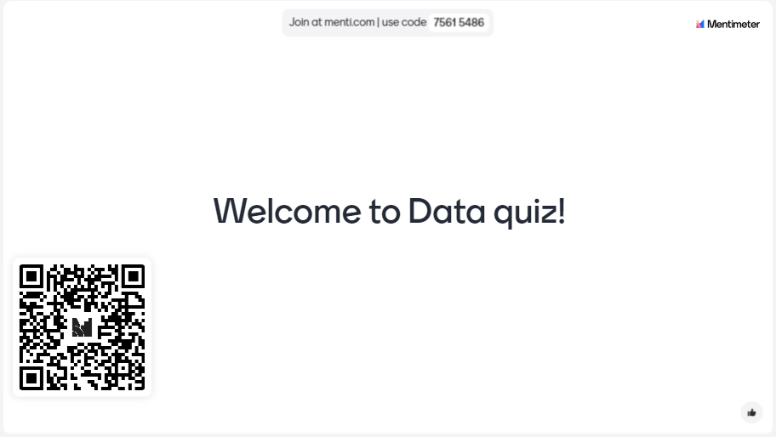

Slide 5
1. Data Project Update and Presentation – 20 mins
At least 3 Projects committed in GitHub link.
Record each project explaining following:-
Problem definition.
Data Collection.
Data Analysis - Data Cleaning and transformation applied in the project.
Key Insights
What complexity did you solve in the project?
What did you achieve from the project?

Slide 6
Data Presentation tips
Clear Structure: Use a clear and logical structure with distinct sections.
Visual Aids: Use charts, graphs, and visuals to make data more understandable and engaging.
Keep It Concise: Be clear and to the point to keep the audience engaged.
Practice: Rehearse your presentation multiple times to ensure smooth delivery.
Engage the Audience: Ask questions and encourage interaction.
Anticipate Questions: Be prepared for questions and have data or explanations ready.
Follow-Up: Provide a summary and next steps at the end of the presentation and offer to follow up with detailed information if needed.

Slide 7
Day 2 (Agenda)
- 15 mins Introduction interview practice.
- 30 mins CV and resume review.
- 30 mins Data Project review.

Slide 8
Day 3 (Agenda)
- 15 mins Introduction interview practice.
- 45 mins CV, Resume, LinkedIn review.
- 45 mins Data Project review.

Slide 9
2. LinkedIn review and tips – 20 mins
1. Profile Photo:
Recommendation: Use a high-quality, professional-looking headshot. Dress appropriately for your industry, and ensure your face is clearly visible.
2. Headline:
Recommendation: Craft a compelling headline that goes beyond your job title. Highlight your value proposition or key skills. For example, “Looking for Entry level Data Analyst role| Open for Data Analyst role.

Slide 10
2. LinkedIn review and tips – 20 mins
3. About Section:
Recommendation: Write a clear and engaging summary that highlights your experience, skills, and career aspirations. Use this space to tell your professional story, including achievements and what drives you. Aim for 3-5 short paragraphs.
4. Experience:
Recommendation: Detail your roles and responsibilities for each position you've held. Focus on achievements and use quantifiable results where possible (e.g., "Increased company revenue by 20% in 6 months"). Use bullet points for easy readability.

Slide 11
2. LinkedIn review and tips – 20 mins
5. Skills Assessment:
Recommendation: Take LinkedIn Skill Assessments to validate your skills. Passing these assessments can boost your profile's visibility. .[MUST]
6. Keywords:
Recommendation: Use industry-specific keywords throughout your profile to improve searchability. Recruiters often use these keywords to find potential candidates.[MUST]

Slide 12
2. LinkedIn review and tips – 20 mins
12. Activity:
Recommendation: Stay active on LinkedIn by posting updates, sharing industry news, and engaging with others' content. Comment on and share posts to increase your visibility. [MUST]

Slide 13
Resume review and tips
1. Contact Information:
Recommendation: Ensure your contact information is up-to-date and professional. Include your name, phone number, email address, LinkedIn profile, and possibly a personal website or GitHub link.

Slide 14
Resume review and tips
2. Professional Summary:
Recommendation: Write a concise summary (2-3 sentences) at the top of your resume that highlights your key skills, experience, and career objectives. Tailor it to the job you're applying for.
Example:- Highly motivated data analytics professional eager to join the tech industry, bringing extensive knowledge and enthusiasm in data insights, visualization, and analytics. Proficient in utilizing tools such as SQL, Python, and Power BI to derive actionable insights. Aiming to leverage strong analytical skills, problem-solving abilities, and a passion for data to make meaningful contributions to a dynamic and innovative team. Committed to continuous learning and staying current with industry trends to drive impactful results.

Slide 15
Resume review and tips
3. Key Skills:
Recommendation: List relevant skills in a separate section. Use bullet points and categorize them if necessary (e.g., Technical Skills, Soft Skills).
Example:-
Key Skills:
- Technical Skills: Python, SQL, Power BI, R, Excel
- Soft Skills: Problem-solving, Communication, Teamwork, Time Management

Slide 16
Resume review and tips
4. Professional Experience:
Recommendation: Detail your work experience in reverse chronological order. For each role, include the job title, company name, location, and dates of employment. Use bullet points to describe your responsibilities and achievements. Quantify your achievements with numbers and percentages where possible.
Example:-
Data Analyst
XYZ Corporation, Sydney, NSW
June 2018 – Present
- Developed and maintained dashboards using Power BI, leading to a 30% improvement in decision-making efficiency.
- Analyzed large datasets using Python and SQL to identify trends and insights, resulting in a 15% increase in sales.
- Collaborated with cross-functional teams to implement data-driven strategies, improving overall project success rates by 20%.

Slide 17
Resume review and tips
5. Education:
Recommendation: List your educational background in reverse chronological order. Include the degree, major, institution, and graduation date. Mention any honors or relevant coursework.
Master of Data Science
Macquarie University
Graduated: May 2020
- Relevant Coursework: Machine Learning, Statistical Analysis, Data Mining
- Honors: Dean's List

Slide 18
Resume review and tips
6. Certifications and Training:
Recommendation: Include any relevant certifications or training programs. Mention the certification name, issuing organization, and date obtained.
Certifications:
- Certified Data Analyst, Data Camp, September 2019
- Power BI Specialist, December 2020

Slide 19
Resume review and tips
Formatting Tips:
Consistency: Use consistent formatting throughout the resume, including fonts, bullet points, and headings.
Readability: Use a clean and professional font (e.g., Arial, Calibri) and ensure there’s enough white space.
Length: Keep your resume to one or two pages, depending on your experience level.
File Format: Save and send your resume as a PDF to ensure the formatting stays intact.

Slide 20
Communication skills & interview tips
Practice answers to common interview questions. Examples include:
Introduce yourself.
Why do you want to work as a data analyst?
Describe a challenging data analysis project you've worked on.
Can you explain the difference between data cleaning and data transformation?

Slide 21
Before the Interview:
Research the Company
Understand the Role
Review Your Resume
Brush Up on Technical Skills
Prepare for Common Questions
Prepare Questions for the Interviewer

Slide 22
During the Interview:
First Impressions Matter
Stay Calm and Confident
Communicate Clearly
Showcase Your Analytical Thinking
Demonstrate Technical Proficiency
Highlight Soft Skills
Ask Your Questions

Slide 23
Questions/Queries

